Slide 1

Financial Literacy: Empowering Economic Stability
Financial literacy means managing money wisely through budgeting, saving, and investing. It helps individuals make informed financial decisions and build economic independence.

Slide 2
Key Insights & Recommendations
Current Challenges
Effective Initiatives
Recommendations
Only 17% of adults in some developing countries are financially literate. Young and marginalized groups face higher risks.
Governments promote literacy via school programs, workshops, and online platforms.
Include financial literacy in school curriculums early on.
Use technology to reach underserved populations.
India’s RBI and SEBI run notable financial education campaigns.
Complex financial products and limited education access worsen inequality.
Partner with private sector to simplify financial products.

Slide 3
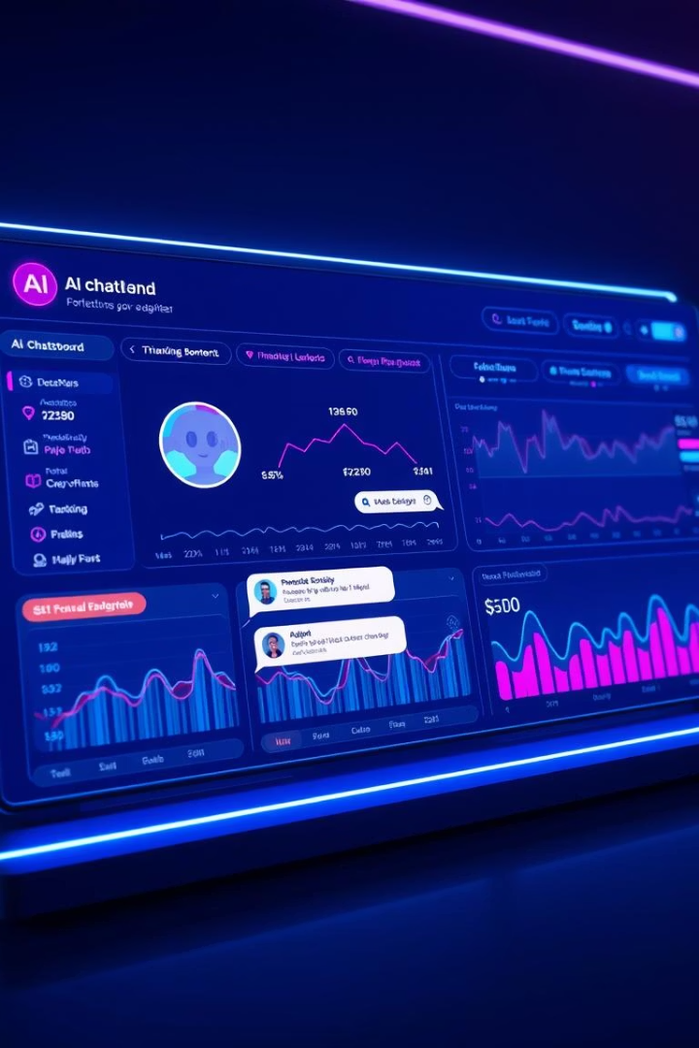
Financial AI Chatbots: Architecture & Capabilities
This presentation explores the architecture of financial AI chatbots.
Learn how voice recognition and AI integrate for smarter financial assistance.

Slide 4
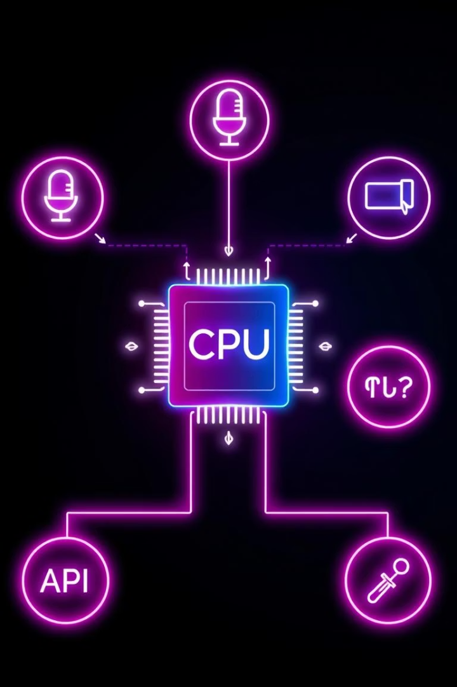
Core Components of the Chatbot Architecture
API Integration
Uses GROQ API key for secure AI query processing.
Speech Recognition
Voice input captured and transcribed with Google Speech API.
Text-to-Speech
pyttsx3 engine converts chatbot responses to natural speech.
Session Management
Maintains conversation state and prompt history for context.

Slide 5





Voice Interaction: Enabling Conversational Finance
Listening
Microphone receives real-time voice commands.
Recognition
Speech is transcribed using robust voice recognition.
Processing
Intent is interpreted by AI modules for financial queries.
Response
Answers generated and spoken back through text-to-speech.

Slide 6

Concurrency & Threading for Smooth UX
Async Speech
Control Flags
Speech synthesis runs on separate threads to prevent UI blocking.
Thread synchronization ensures clean start and stop of audio output.
COM Initialization
Windows COM interfaces initialized for thread-safe audio operations.

Slide 7
Key Takeaways and Next Steps
Financial Literacy
Integration Flexibility
Future Enhancements
Chatbots simplify complex financial topics through conversation.
Combines voice, AI, and session state for seamless experience.
Expand NLP capabilities and embed real-time market data.
Next steps include testing user interactions and scaling AI models.

